Slide 1

Phonepe Pulse Data Visualization and Exploration: A User-Friendly Tool Using Streamlit and Plotly
By
UMARANI thangavelu

Slide 2
content
what is phonepe
Technologies
Problem Statement
Used packages
SQL connection
Visualization and plots

Slide 3
what is phonepe
PhonePe is a digital wallet payment method used by consumers to pay for mobile recharges, e-commerce orders, utility bill payments, travel, and more.

Slide 4
Technologies
Github Cloning,
Python, Pandas,
MySQL,
mysql-connector-python,
Streamlit, and Plotly.

Slide 5
Problem Statement
Extract data from the Phonepe pulse GitHub repository through scripting and
clone it..
2. Transform the data into a suitable format and perform any necessary cleaning
and pre-processing steps.
3. Insert the transformed data into a MySQL database for efficient storage and
retrieval.
4. Create a live geo visualization dashboard using Streamlit and Plotly in Python
to display the data in an interactive and visually appealing manner.
5. Fetch the data from the MySQL database to display in the dashboard.
6. Provide at least 10 different dropdown options for users to select different
facts and figures to display on the dashboard.

Slide 6
Importing the Libraries
import streamlit as st
from streamlit_option_menu import option_menu
import plotly.express as px
import pandas as pd
import sql
import mysql.connector
import json
import requests

Slide 7
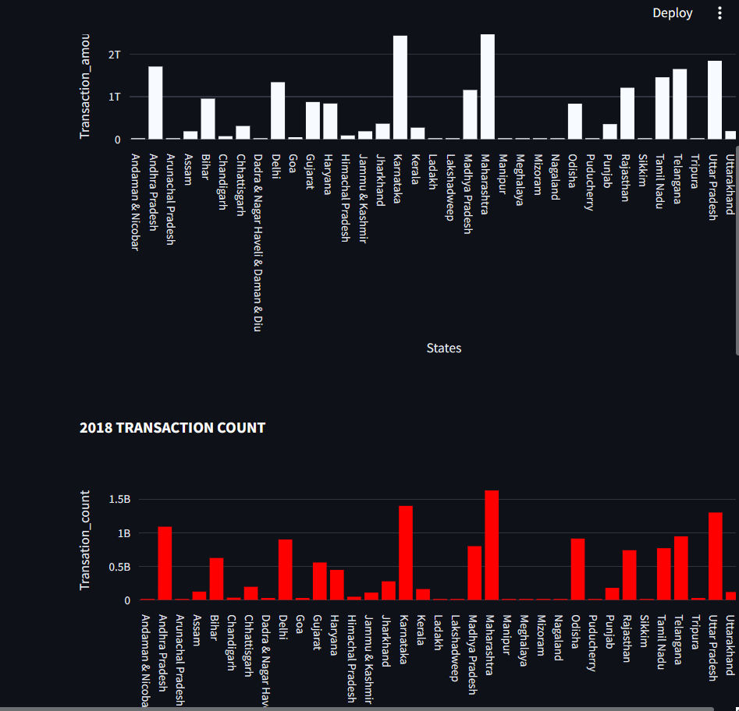
Visualization and plots
Matplotlib is an easy-to-use, low-level data visualization library that is built on NumPy arrays. It consists of various plots like scatter plot, line plot, histogram, etc. Matplotlib provides a lot of flexibility.
Plots:

Slide 8
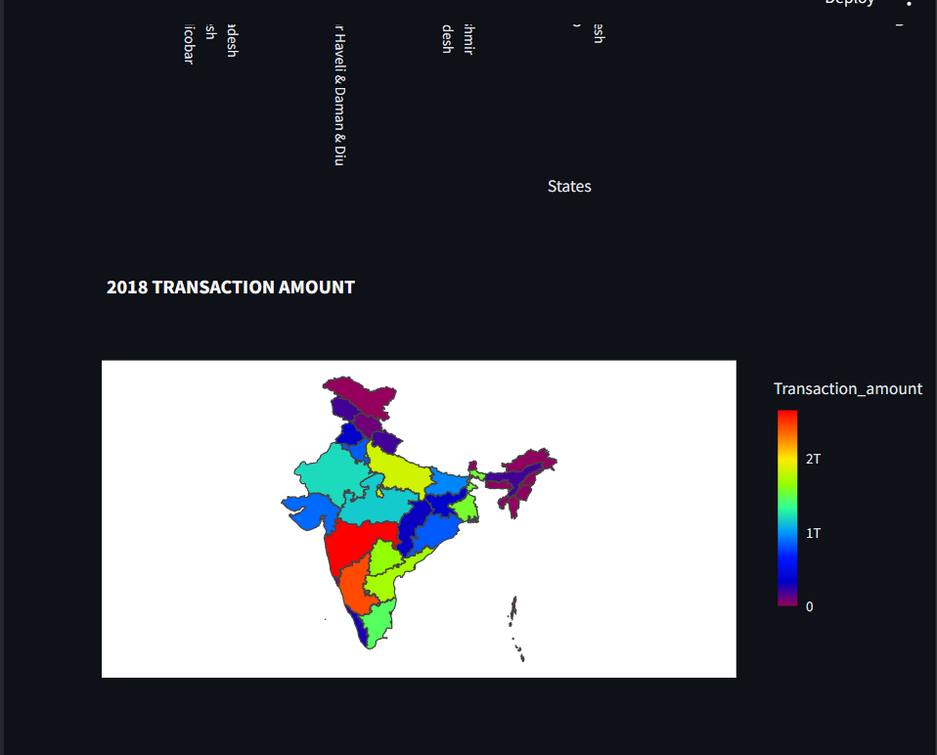

Slide 9
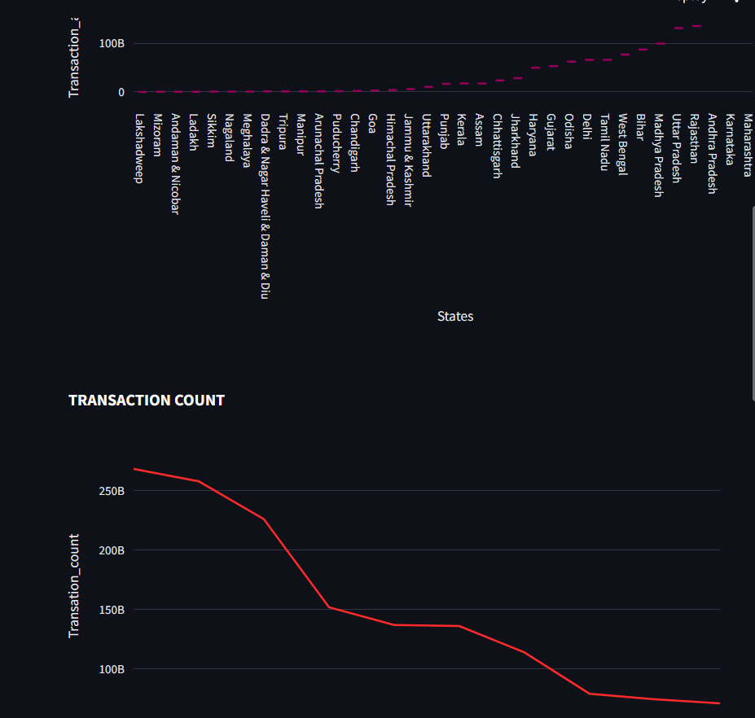

Slide 10
Thank You
-

